Slide 1
ECEG-5193: Algorithm Analysis and Design
Algorithm Design Techniques
Amortized Analysis

Slide 2
What is Amortized Analysis?
Amortize:
to put money aside at intervals for gradual payment of a debt. (Webster)

Slide 3
What is Amortized Analysis?
Data structures typically undergo a sequence of operations, not just a single operation.
Average case analysis makes unrealistic assumptions about input, often hard to justify.
Worst-case analysis simply adds up the worst possible times of the individual operations.
Can be unduly pessimistic.
Amortized analysis offer a nice balance.

Slide 4
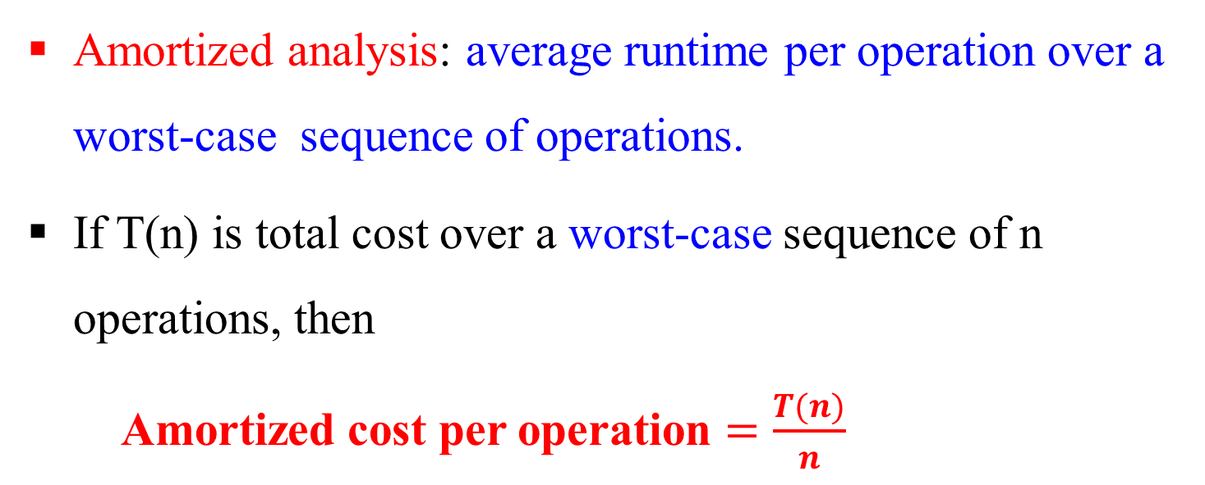
Why Amortized Analysis?
Amortized analysis: average runtime per operation over a worst-case sequence of operations.
If T(n) is total cost over a worst-case sequence of n operations, then Amortized cost per operation $=\frac{T(n)}{n}$
Results are both realistic and robust.
Only an analysis technique, not a algorithm design method.

Slide 5
Amortized Analysis: 3 Methods
We will discuss 4 different methods for amortized analysis:
Aggregate Method
Accounting Method
Charging Method
Potential Method

Slide 6
Amortized Analysis of Table doubling
We want to store n elements in a table of size m = Θ(n).
One idea is to double m whenever n becomes larger than m (due to insertions).
The cost to double a table of size m is clearly Θ(m) = Θ(n), which is also the worse case cost of an insertion.

Slide 7
Table doubling
a
a
b
a
b
c
d
a
b
c
d

Slide 8
Amortized Analysis of Table doubling
But what is the total cost of n insertions? It is at most
a | b | c | d | e | f | g | h | i | j | k | l | m | n | o | p | q | r | s | t | u | v | w | x | y | z | A | B | C | D | E | F
1 |  | 1 |  | 1 | 1 | 1 |  | 1 | 1 | 1 | 1 | 1 | 1 | 1 | 1 | 1 |  | 1 | 1 | 1 | 1 | 1 | 1 | 1 | 1 | 1 | 1 | 1 | 1 | 1
2
4
8
16
32
2⁰ + 2¹ + 2² + ··· + 2^{lg n} = Θ(n).
In this case, we say each insertion has:
Θ(n)/n = Θ(1) amortized cost.

Slide 9
Aggregate Method
The method we used in the above analysis is the aggregate method: just add up the cost of all the operations and then divide by the number of operations.
total cost of k operations
amortized cost per operation =
k
Aggregate method is the simplest method. Because it’s simple, it may not be able to analyze more complicated algorithms.

Slide 10
Amortized Bound Definition
Amortized cost can be, but does not have to be, average cost.
We can assign any amortized cost to each operation, as long as they “preserve the total cost”, i.e., for any sequence of operations,
where the sum is taken over all operations.

Slide 11
Amortized Bound Definition
For example, we can say a 2-3 tree achieves
O(1) amortized cost per create,
O(lg n∗) amortized cost per insert, and
0 amortized cost per delete,
The reason we can claim this is that for any sequence of operations, suppose there are
c creations,
i insertions and d ≤ i deletions (cannot delete from an empty tree),
The total amortized cost is asymptotically the same as the total actual cost: O(c + i lg n∗ + 0d) = O(c + i lg n∗ + d lg n∗ )
Notes:
You can never delete more than you insert. Deletion cost is bound by insert.
n∗ is the maximum size of the 2-3 tree during the entire sequence of operations.
Later, we will tighten the amortized cost per insert to O(lg n) where n is the current size.

Slide 12
Accounting Method
Allows an operation to store credit into a bank for future use,
if its assigned amortized cost > its actual cost;
Allows an operation to pay for its extra actual cost using existing credit,
if its assigned amortized cost < its actual cost.

Slide 13
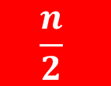
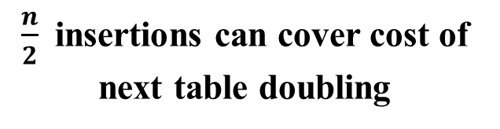
Accounting Method: Table doubling example
Each insert operation cots 3units
Use 1$ for insert and store 2units for future use
2
2
1
3
1
3
1
5
a
3
9
$\frac{n}{2}$ insertions can cover cost of next table doubling
1
2
a
b
$$\frac{n}{2}$$
a
1
2
2
b
c
d
1
2
2
2
2
a
b
c
d
e
f
g
h

Slide 14
Accounting Method
For example, in table doubling:
if an insertion does not trigger table doubling, store a coin representing c = O(1) work for future use.
if an insertion does trigger table doubling, there must be n/2 elements that are inserted after the previous table doubling, whose coins have not been consumed. Use up these n/2 coins to pay for the O(n) table doubling.
amortized cost for table doubling: O(n) − c · n/2 = 0 for large enough c.
amortized cost per insertion: 1 + c = O(1).

Slide 15
Charging Method
The charging method allows operations to charge cost retroactively to past operations.
Amortized cost of an operation =
Actual cost of this operation
− Total cost charged to past operations
+ Total cost charged by future operations

Slide 16
Charging Method: Table doubling example
When the table doubles from m to 2m, we can charge Θ(m) cost to the m/2 insert operations since the last doubling.
Each insert is charged by Θ(1), and will not be charged again.
So the amortized cost per insert is Θ(1).
a
b
c
d
Notes:
the table is half full again after any resize (doubling or shrinking).

Slide 17
Charging Method: Table halving example
The motivation is to save space
when with deletes.
When to shrink the table size from m to m/2.
If the table is down to 1/4 full, n = m/4, we shrink the table size from m to m/2 at Θ(m) cost.

Slide 18
Charging Method
Table doubling/halving
After any resize (doubling or shrinking), the table is half full
Each table doubling still has ≥ m/2 insert operations to charge to, and
Each table halving has ≥ m/4 delete operations to charge to.
So the amortized cost per insert or delete is still Θ(1).

Slide 19
Potential Method
This method defines a potential function Φ that maps a data structure (DS) configuration to a value.
This function Φ is equivalent to the total unused credits stored up by all past operations (the bank account balance).
amortized cost of an operation = actual cost of this operation + ΔΦ
ΔΦ = Φ(DS after operation) – Φ(DS before operation)

Slide 20
Potential Method
In order for the amortized bound to hold,
Φ should never go below Φ(initial DS) at any point.
If Φ(initial DS) = 0, which is usually the case, then
Φ should never go negative (intuitively, we cannot ”owe the bank”).

Slide 21
Potential Method
Relation to accounting method
In accounting method, we specify ΔΦ,
In potential method, we specify Φ.
One determines the other, so the two methods are equivalent.
Find a potential function is a challenging part
Notes:
But sometimes one is more intuitive than the other.
ACC: Bank balnce of a particular state depends on previous state
POT: can be used to independently derive the potential at any state
Finding the potential function is the tricky part

Slide 22
Potential Method: Table doubling
Define Φ = 2n – size.
a
Φ = 2 · 1 – 2 = 0
a
b
Φ = 2 · 2 – 4 = 0
a
b
c
Φ = 2 · 3 – 4 = 2
a
b
c
d
Φ = 2 · 4 – 8 = 0
Amortized cost of i^{th} operation h_{i} = c_{i} + Φ(h_{i}) – Φ(h_{i-1})

Slide 23
Potential Method: Table doubling
Φ = 2n – size
h_{i} = c_{i} + Φ(h_{i}) – Φ(h_{i-1})
Case 1: Normal operation
h_{i} = c_{i} + 2i – size – (2(i-1) – size)
h_{i} = c_{i} + 2i – size – (2i – 2 – size)
h_{i} = c_{i} + – ( – 2 )
h_{i} = c_{i} + 2
For normal operation: c_{i} = 1
h_{i} = 1 + 2
h_{i} = 3
= 3

Slide 24
Potential Method: Table doubling
Φ = 2n – size
h_{i} = c_{i} + Φ(h_{i}) – Φ(h_{i-1})
Case 2: Table doubling
c_{i} = 1 + i
h_{i} = (i + 1) + 2i – ? – (2(i-1) – ?)
h_{i} = (i + 1) + 2i – 2i – (2(i-1) – i)
h_{i} = (i + 1) + 2i – 2i – (2(i-1) – i)
h_{i} = i + 1 – (i – 2)
h_{i} = (i + 1) – (2i – 2 – i)
h_{i} = i + 1 – i + 2
h_{i} = (i +1) – (2i – 2 – i ) )
h_{i} = 1 + 2
h_{i} = (i +1) – (2i – i – 2)
h_{i} = 3
h_{i} = (i +1) – (i – 2)

Slide 25
More Examples

Slide 26
Amortized Analysis of Stack with MultiPop
Stack data structure has two operations:
Push(S, x) — push x onto stack S.
Pop (S) — pop the top element of S.
Each of these ops has worst-case cost O(1).
Add a new operation MultiPop (S, k): it pops top k elements of S.
MultiPop (S, k)
while S ≠ ∅ and k > 0 Pop (S)
k = k − 1 end

Slide 27
Amortized Analysis of Stack with MultiPop
Worst-case complexity of n MultiPop Stack ops?
Because any single MultiPop can be Θ(n), the standard worst-case bound is O(n²).
But this is overly pessimistic.

Slide 28
Amortized Analysis
Theorem: A sequence of n ops, on an initially empty stack, has cost O(n).
Proof:
Each element is popped at most once
Either by Pop or during a MultiPop.
Total cost of Pops, including MultiPops, is ≤ number of Pushes, which is at most n.
Total cost of all operations is T(n) ≤ 2n.
Thus, amortized cost per operation for this stack is at most 2.
This bound holds in worst-case, over any sequence!

Slide 29
Amortized Analysis of a Binary Counter
Binary counter implemented as an array of bits: A[0 · · · k − 1].
Consider incrementing A starting from 0.
Increment (A)
i = 0;
while i 6= k and A[i] = 1
A[i] = 0; i = i + 1;
if i < k then A[i] = 1;
Cost of Increment is number of bits flipped.

Slide 30
Amortized Analysis of a Binary Counter
Binary counter bit sequence:
Value Bits Cost 0 0 · · · 000 0
1 0 · · · 001 1
2 0 · · · 010 2
3 0 · · · 011 1
In the worst-case, a single increment can flip k bits.
There are n increments, so by standard worst-case analysis, the cost is O(nk).

Slide 31

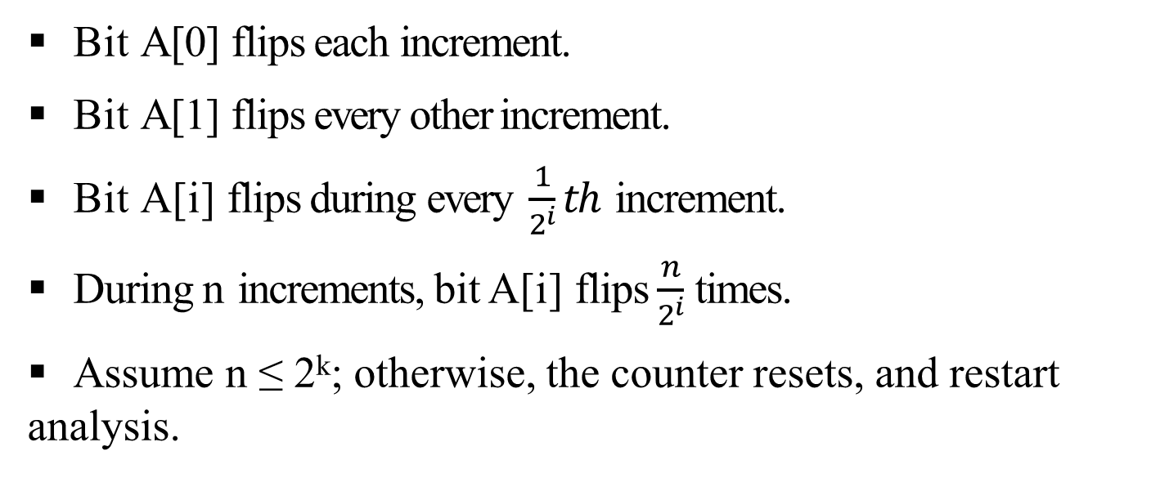
Binary Counter Analysis
Theorem: Starting with 0, worst-case cost of n increments is O(n).
Proof:
Bit A[0] flips each increment.
Bit A[1] flips every other increment.
Bit A[i] flips during every $\frac{1}{2^{i}}th$ increment.
During n increments, bit A[i] flips $\frac{n}{2^{i}}$ times.
Assume n ≤ 2^{k}; otherwise, the counter resets, and restart analysis.
Total cost
Amortized cost per increment is 2.

Slide 32
Accounting Method: Second Method of Analysis
Assign different charges to different operations, some more, some less than true cost.
These (amortized) charges are artificial, but make the accounting for the total cost easier.
When an operation’s amortized cost > true cost, the data structure accrues credit.
These credits help pay for operations for which amortized cost < true cost.
The accounting method makes the first real use of the amortization principle: the aggregate method doesn’t really assign varying costs to individual operations.

Slide 33

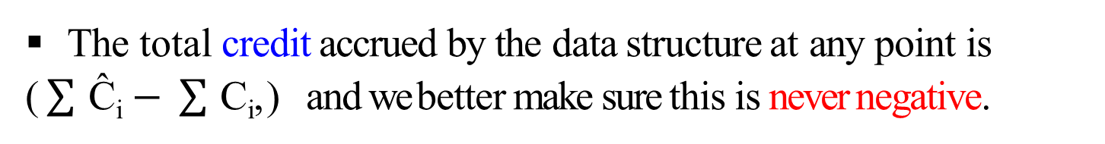
Accounting Method
The key is to choose the amortized costs carefully.
Suppose the actual cost of the ith operation is C_{i}, and we use some other cost Ĉ_{i} as its amortized cost.
Then, we have to make sure that, for any possible sequence of n operations,
$$\sum_{i=1}^{n}{{\text{Ĉ}}_{i}≥\sum_{i=1}^{n}{C_{i}}}$$
The total credit accrued by the data structure at any point is
($\sum{\text{Ĉ}\text{i}}−\sum{\text{C}\text{i}}$,) and we better make sure this is never negative.

Slide 34
Accounting Method Analysis of Stack
The actual costs (C_{i}) of operations in the stack example are:
1 for Push
1 for Pop
min(k, s) for MultiPop, where s is the stack size when the MultiPop is called.
Let us assign the following amortized costs (Ĉ_{i}) to these ops:
2 for Push
0 for Pop
0 for MultiPop.
The amortized cost of MultiPop is a constant (in fact, 0), even though it’s real cost if variable. The intuition is that the credit accrued through Push operations will be enough to pay for the actual cost of MultiPop.

Slide 35
Accounting Method Analysis of Stack
Think of stack as a bank, where each deposit and withdrawal costs $1.
When an item is Pushed onto the stack, we use $1 for the Push operation, and leave the second dollar (of its amortized cost) with the item in the bank.
This second (spare) dollar will be used to pay for the item’s Pop.
The item may be popped either through a single Pop or a MultiPop, but since each item in the stack has a spare dollar allocated to it, the Pop and MultiPop can be entirely paid using that credit.
The amortized cost of Pop and MultiPop is therefore 0.
Thus, for any sequence of n Push, Pop, MultiPop, the total amortized cost is O(n), and it is an upper bound on the actual cost.
Similar analysis for the Binary Counter.

Slide 36
Potential Method: Third Method of Analysis
Keep track of the potential energy of the data structure.
Start with initial data structure D₀, and perform n updates.
Let C_{i} be the actual cost of ith op; let D_{i} be data structure state after op i.
Function Φ measures potential of data structure.
Define amortized cost of operation i as
Ĉ_{i} = C_{i} + Φ(D_{i}) − Φ(D_{i−1}).

Slide 37
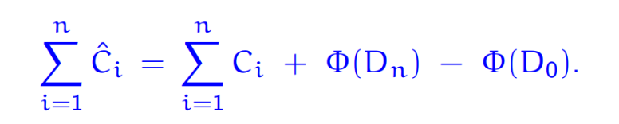
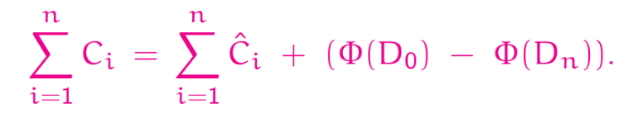
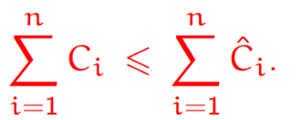
Potential Method
Since Ĉ_{i} = C_{i} + Φ(D_{i}) − Φ(D_{i−1}), by adding them up over the sequence, we get
Rewriting, we get the total actual cost as
Suppose Φ(D_{i}) > Φ(D₀), for all i, then

Slide 38
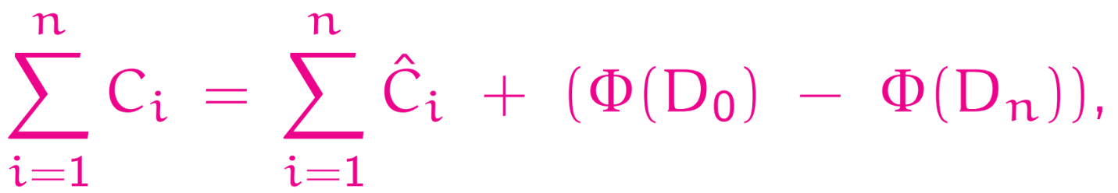
Potential Method
Actual cost of operations is
The last term is non-positive (Φ(Di) ≥ Φ(D0)).
So, amortized cost is an upper bound on actual total cost.
The most creative part of the analysis is often the choice of Φ.

Slide 39
Potential Method Analysis of MultiPop Stack
Let Φ = number of items on stack.
Clearly, Φ(D₀) = 0, and Φ(D_{i}) > Φ(D₀) = 0.
Amortized cost of Push:
C_{i} + (Φ(D_{i}) − Φ(D_{i−1})) = 1 + 1 = 2
Amortized cost of Pop:
C_{i} + (Φ(D_{i}) − Φ(D_{i−1})) = 1 − 1 = 0
Amortized cost of MultiPop (S, k):
C_{i} + (Φ(D_{i}) − Φ(D_{i−1})) = min(s, k) − min(s, k) = 0.
Thus, amortized cost per operation is O(1).

Slide 40
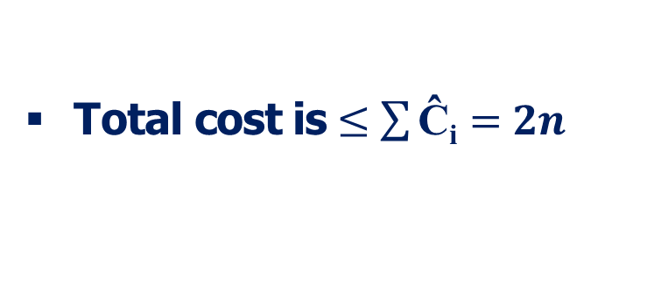
Potential Method Analysis of Binary Counter
Let Φ_{i} = Φ(D_{i}) be the number of 1’s in the counter after ith op.
Clearly, Φ_{i} > 0, for all i.
Suppose ith Increment resets t_{i} bits.
Actual cost C_{i} = t_{i} + 1.
If Φ_{i−1} = b_{i}, then Φ_{i} = b_{i} − t_{i} + 1.
Amortized cost
Ĉ_{i} = C_{i} + (Φ_{i} − Φ_{i−1})
= (t_{i} + 1) + (b_{i} − t_{i} + 1 − b_{i})
= 2
Total cost is $≤\sum{\text{Ĉ}\text{i}}=2n$

